Slide 1
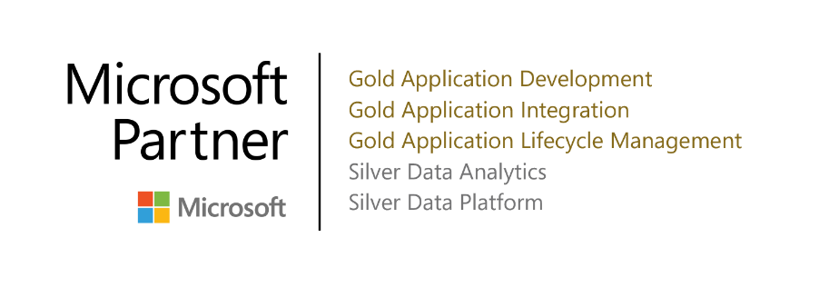
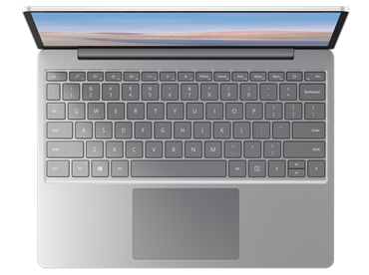
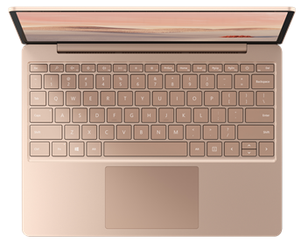
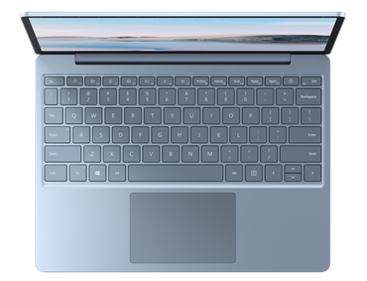
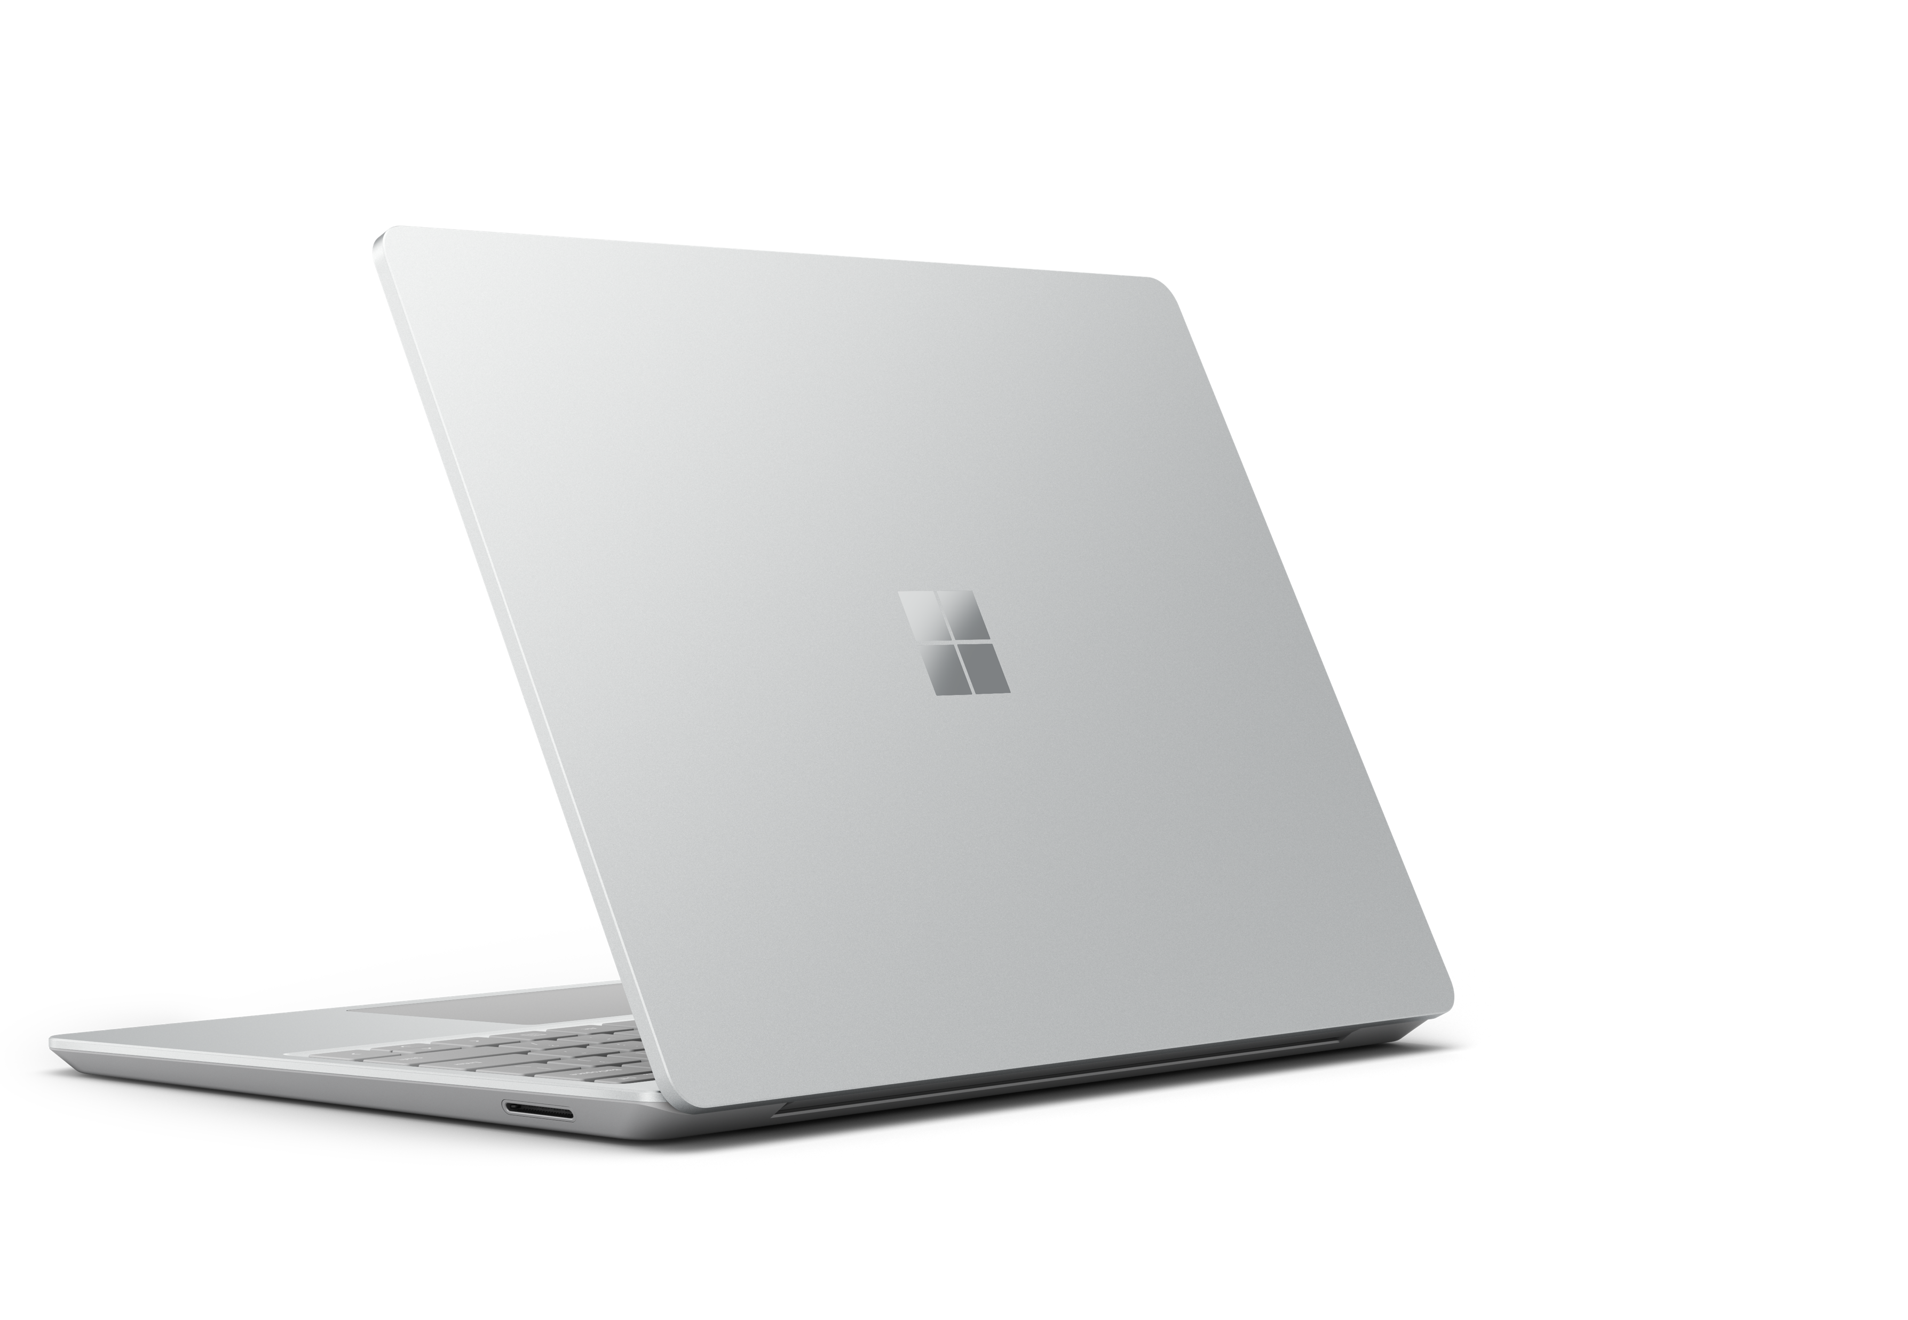
Goodbye desktop. Hello Surface Laptop Go.
Now is the time to put the essential device for everyday experiences into the hands of your employees.
As you emerge from 2020 and focus on new ways to work and grow your business, there’s an opportunity to build a modern and sustainable device strategy for a resilient future.
The Microsoft Surface Laptop Go brings together the premium experience and performance you expect from a Surface device—at a price point that makes it an option for replacing desktop PCs.
The “work from virtually anywhere” laptop The Surface Laptop Go provides sleek style in a classic clamshell design. Weighing just 2.45 pounds, the device can easily be taken anywhere your people need to work.
Essential tools for remote workers The 12.4“¹ PixelSense™ touchscreen and full-size keyboard helps workers do more. Remote workers can easily collaborate with Omnisonic sound, Dolby® Audio, and a 720 HD camera. Windows 10 Pro comes standard.
Premium performance for optimal productivity With the combination of a 10th Gen Intel® Core™ i5 processor and all-day battery life², employees can power through virtual meetings and run the apps they need. Leverage Surface Dock 2* to connect to external monitors for a desktop experience.
Get your hybrid workforce up and running—fast and secure Laptop Go is shipped with Windows Autopilot to reduce IT complexity for secure device deployment straight to employees. One Touch sign-in with the Fingerprint Power Button is included for security.
Next steps
Insert call to action here.
*Sold separately.
¹ Surface Laptop Go display has rounded corners within a standard rectangle. When measured as a standard rectangular shape the screen is 12.45” diagonally (actual viewable area is less).
² Surface Laptop Go battery life: Up to 13 hours of battery life based on typical Surface device usage. Testing conducted by Microsoft in September 2020 using preproduction software and preproduction configurations of Surface Laptop Go Intel® Core™ i5, 128GB, 8 GB RAM Microsoft Surface® Edition devices. Testing consisted of full battery discharge with a mixture of active use and modern standby. The active use portion consists of (1) a web browsing test accessing 8 popular websites over multiple open tabs, (2) a productivity test utilizing Microsoft Word, PowerPoint, Excel and Outlook, and (3) a portion of time with the device in use with idle applications. All settings were default except screen brightness was set to 150nits with Auto-Brightness disabled. Wi-Fi was connected to a network. Battery life varies significantly with settings, usage and other factors.

